Slide 1
Industrial Management
Jahid Hasan
Assistant Professor
Dept. of IPE,SUST.

Slide 2
Introduction of Management
One of the most important activities in business is the management of the 4M’s – men, machines, material and money.
it may comprise the activities of executives and administrative personnel in an organization, while in another, it may refer to a system of getting things done.
management can be considered as the proper utilization of people and other resources in an organization to accomplish desired objectives.
With increasing global competition, changes in the world of technology, changing business practices and increasing social responsibility of organizations, the role of managers has become all the more significant.

Slide 3
Definition -Management
The term ‘management’ can be interpreted in a variety of ways.
Harold Koontz and Heinz Weihrich define management as “the process of designing and maintaining an environment in which individuals, working together in groups, efficiently accomplish selected aims.”
Louis E. Boone and David L. Kurtz define management as “the use of people and other resources to accomplish objectives.”
Dalton E. McFarland defines management as “a process, by which managers create, direct, maintain, and operate purposive organizations through systematic, coordinated, cooperative human effort.”
Mary Parker Follet termed management as “the act of getting things done through people.”

Slide 4
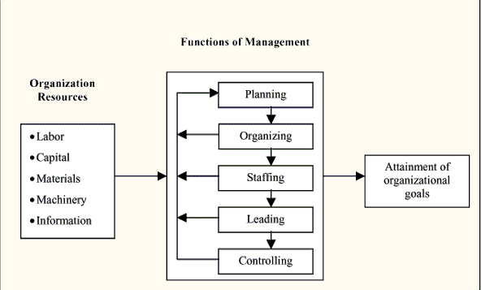
Definition -Management
-Managers carry out the functions of planning, organizing, staffing, leading and controlling.
-Henry Fayol was the first management thinker to outline the five basic functions carried out by managers.

Slide 5
Management is essential to any kind of organization:.
Wherever there are groups of people working together to achieve some common objectives, it becomes essential to guide, organize and control them. The term ‘management’ applies to any organization irrespective of the size or nature of operations.
The prime concern of a CEO of a multinational company, the General Manager of a hotel, the first-level supervisor, the manager of a cricket team and the student president in a college is to manage their people and resources effectively.
Management is essential at all hierarchical levels: Management is necessary at all levels. However, the type of skills and the degree to which various skills are required at different levels of the hierarchy may vary. In order to perform their duties satisfactorily, managers need technical, human, conceptual and design skills.

Slide 6
Types of Managers
Jack Welch in his book “Straight from the Gut” speaks about four types of managers, depending on their ability to achieve set targets, while maintaining the company’s values.
The Type 1 managers live up to the expectations of the company. They are able to deliver commitments and share the company’s values. It is easy to decide the future of such employees.
The Type 2 managers neither share the company’s values nor do they achieve their targets. Though not very pleasant, it is also easy to decide the future of such employees.

Slide 7
Types of Managers
The Type 3 managers share the values of the company but their performance is dismal. They generally are not able to deliver the numbers. Welch says that GE believes in giving them another chance to prove themselves. They may be asked to work in a different work environment so as to allow them to start afresh. Welch states that there have been some wonderful transformations and some of the managers who are given a second chance do prove their worth.
The Type 4 managers are the most troublesome. These are the managers, who fulfill all commitments and give results but do not share the company’s values. These managers coerce people to perform and subordinates are generally afraid of them. Yet, because of their ability to deliver the numbers, top management tends to overlook their tyrannical behavior.

Slide 8
The goal of all managers is to generate surplus: The aim of all business managers is to create a surplus.
To accomplish this objective, the manager has to create an environment which encourages people to accomplish as much as possible with the least amount of resources and personal dissatisfaction.
Even in non-profit organizations, the aim of managers is to accomplish their goals with the minimum amount of resources or to make as much surplus as possible with available resources.

Slide 9
The aim of all managers is to improve productivity, efficiency and effectiveness: Productivity is defined as “the output-input ratio within a time period with due consideration for quality.” It can be expressed as:
Productivity = Outputs / Inputs (within a time period, quality considered)
Productivity can be improved in the following ways:
-By producing more output with the same inputs.
-By reducing inputs, but maintaining the same level of outputs.
By increasing outputs and reducing inputs, thereby, making the ratio more favorable.
Productivity can be improved by ensuring efficiency and effectiveness in the operations of the firm. Effectiveness refers to achievement of stated organizational objectives while efficiency denotes the judicious use of resources to achieve organizational objectives.
In the words of Peter Drucker, efficiency means “doing things right”, while effectiveness means “doing the right things.” In his book, “Management – Tasks, Responsibilities, Practices”, Drucker states that effectiveness is the foundation of success whereas efficiency is a minimum condition for survival after success has been achieved.

Slide 10
The Role of Management
As mentioned earlier, managers perform five functions – planning, organizing, staffing, leading and controlling. Since these functions are very essential for effective management, they have been used as the basic framework for this book. They have been briefly explained in the next section of the chapter.
In order to understand the role of management, in the late 1960s, Henry Mintzberg devised a new approach – the managerial roles approach – by observing what managers actually do. He did a careful study of five chief executives at work and found that they were involved in a number of varied, unpatterned activities of short duration. Using a method called structured observation, Mintzberg isolated ten roles which he believed were common to all managers. As shown in Table 1.1, these ten roles were grouped into three categories – interpersonal roles, informational roles and decisional roles.

Slide 11
A manager is required to interact with many people, both within and outside the organization and hence, the need to perform interpersonal roles. The three interpersonal roles of a manager are figurehead, leader and liaison. In his role as a figurehead, a manager performs all the ceremonial or symbolic duties. Example, it would be the duty of a college dean to award diplomas at the convocation ceremony. In the leadership role, a manager is required to motivate the employees to perform at their best to achieve the company’s objectives. In the liaison role, a manager is required to interact with people both within and outside the organization.
A manager acts as a channel of information within the organization. The three informational roles of a manager are that of a recipient, disseminator and spokesperson. In the role of a recipient, a manager receives information pertaining to changes, opportunities and problems that the organization may face. As a disseminator, a manager provides information to subordinates that would influence their performance at work. And finally, a manager performs the role of a spokesperson when he or she represents the organization in public.

